Slide 1
The following presentation was prepared by Rev. Daryl Gehlbach and presented at the 2017 ILDA Convention held at Indianapolis, Indiana.

Slide 2

Notes:
ILDA Emblem

Slide 3
International Lutheran Deaf Association
How It All Started
© 2017 Rev. Daryl Gehlbach

Slide 4
1873
1971
Notes:
The roots of the International Lutheran Deaf Association go back almost a century (100 years) before ILDA began.

Slide 5
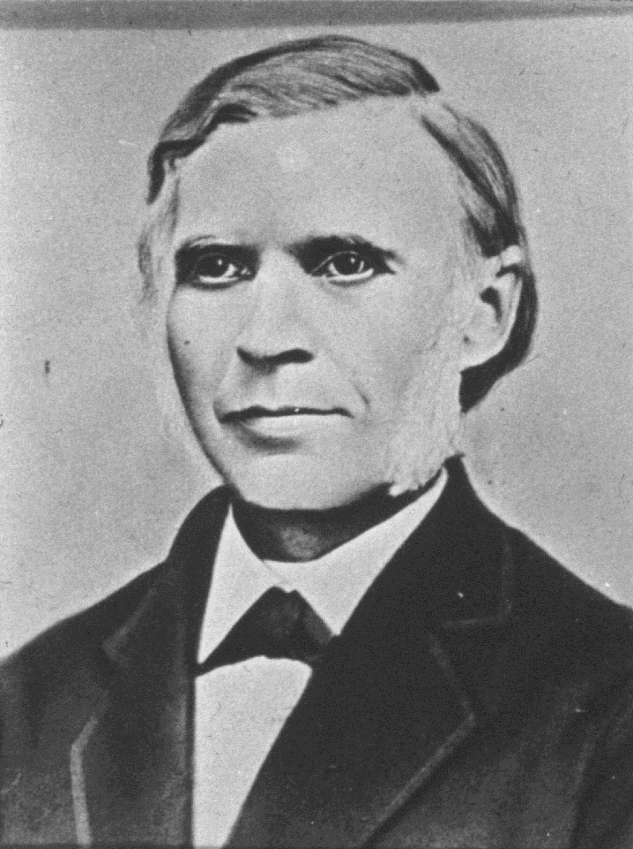
Lutheran School for the Deaf, Detroit
In 1873 a group of congregations in and around Detroit established the Evangelical-Lutheran Orphanage and Deaf Institute.
The first director, Rev. Philip Speckhard, was a former teacher for the deaf in Germany.
Within 15 months there were more deaf students than orphans.
Notes:
Lutheran School for the Deaf, Detroit
In 1873, a group of congregations in an around Detroit agreed to establish an orphanage.
The first director, Rev. Philip Speckhard, was a former teacher of the deaf in Germany.
At the time the association called him Speckard was instructing two deaf girls in his congregation at Sebewaing, Michicagn. The parents wanted him to finish their religious education, so he agreed to bring them to Detroit.
The association agreed to operate a school for the deaf together with the orphanage. And in the Fall, the Evangelical-Lutheran Orphanage and Deaf Institute began.
Within 15 months there were more deaf students than orphans.

Slide 6
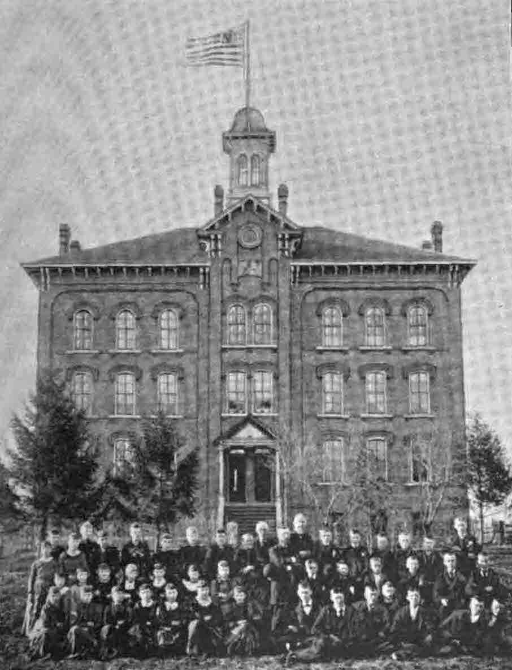
Lutheran School for the Deaf, Detroit
In 1875 the orphans were moved to a newly built home in Addison, Illinois.
The institute became a full time residential Lutheran school for the Deaf.
Students came from as far away as New York, Nebraska, Dakotas, Ontario – even one from Dresden, Saxony.
Notes:
The association knew it could not operate the two institutions together. After conferring with synod officials, the association decided to move the orphans to a newly built home in Addison, Illinois. Thus in 1875 the institute became a full-time school for the Deaf.
Students from as far-away as New York, Nebraska, the Dakotas, Ontario – even one from Dresden, Saxony. These students, especially the graduates, became the scattered seed that helped spread Deaf Missions. They often formed the nucleus for preaching stations and congregations.

Slide 7
1873 1893
Notes:
We now skip twenty years to 1893.

Slide 8
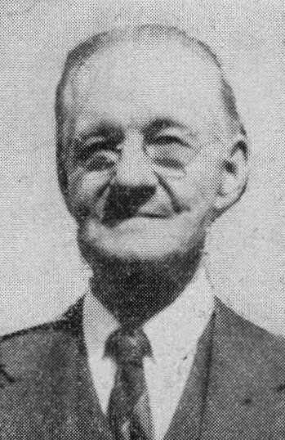
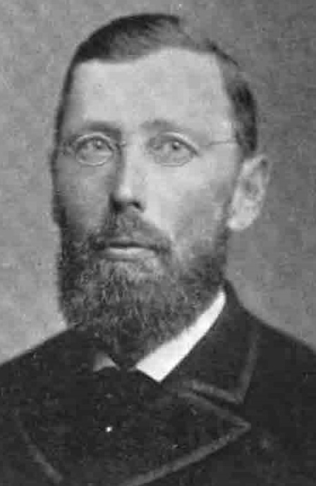
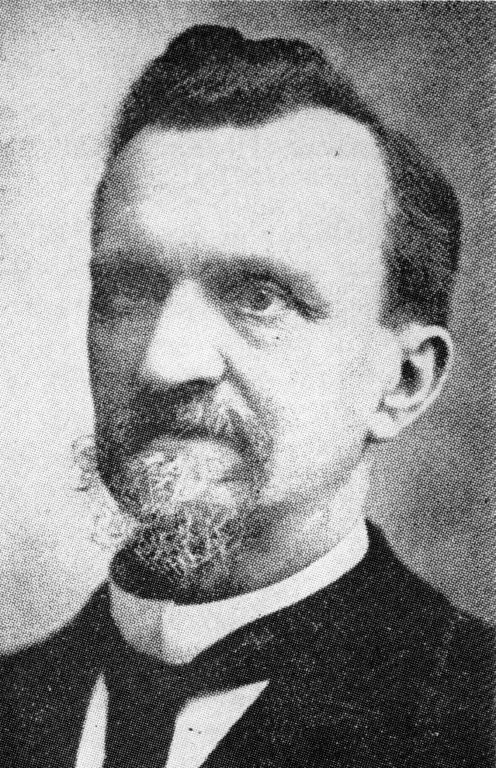
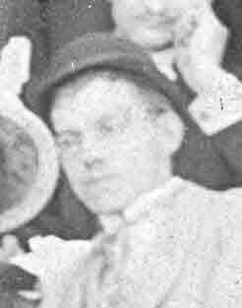
Missouri Synod Deaf Missions Begin
Edward Pahl
Daniel Uhlig
August Reinke
Notes:
Missouri Synod Deaf Missions Begin
There are three names that you should know –
Edward Pahl
Daniel Uhlig
Augustus Reinke

Slide 9
Missouri Synod Deaf Missions Begin
Edward Pahl graduated in 1884 from the Detroit school, and lived in Michigan City, Indiana, near Chicago.
He wrote to Director Daniel Uhlig.
He made an impassioned plea for a Lutheran pastor to preach the Gospel to the Deaf in sign language.
Notes:
Edward Pahl graduated in 1884 from the Detroit school, and lived in Michigan City, Indiana, near Chicago. He was a member of Bethlehem Lutheran Church, Chicago.
Pahl wrote to Director Daniel Uhlig. He made an impassioned plea for a Lutheran pastor to preach the Gospel to the Deaf in sign language. His letter included the following: [next slide]

Slide 10
Missouri Synod Deaf Missions Begin
“Jesus says, ‘Preach the gospel to every creature, teach all nations.’ Who preaches to the deaf? Should they remain without God’s Word? Should they go to the Methodists and the Baptists? … Is it not possible to find a pastor, especially in the larger cities, who would also desire to serve the poor deaf with God’s Word?”

Slide 11
Missouri Synod Deaf Missions Begin
Director Uhlig contacts Rev. August Reinke, pastor of Bethlehem Lutheran Church, Chicago, the largest congregation in Synod.
Reinke meets with Ed Pahl to learn the sign language and practice.
March 4, 1894, Reinke conducts the first Lutheran worship service for the deaf in sign language in the USA.
Notes:
Director Uhlig contacted Rev. August Reinke, pastor of Bethlehem Lutheran Church, Chicago, the largest congregation in Synod. He encouraged Reinke to take up the work. Uhlig very clearly stated that if Reinke was unwilling or unable to take up the task, then there was another pastor he would contact.

Slide 12
Missouri Synod Deaf Missions Begin
For the next two years Reinke travels to other cities and conducts similar services for the deaf.
In 1896 he addresses the Synod in convention and proposes that Synod take up this work.
Synod establishes a Deaf Mission Board to supervise and implement the work.
Notes:
Reinke investigated, and came to understand the genuine need and desire for signed services. He began meeting with Ed Pahl to learn the sign language and practice.
On March 4, 1894, Reinke conducts the first Lutheran worship service for the deaf in sign language in the USA. (In two years, 2019, we will celebrate the 125th anniversary of this worship service.)
For the next two years Reinke traveled to other cities and conducted similar services for the deaf. (His itinerary included a service at the author’s home town church – Lincoln, Illinois.)
In 1896, he addressed the Synod in convention and proposed that Synod take up this work. In a unanimous vote, the convention agreed. It established a Deaf Mission Board to supervise and implement the work. Augustus Reinke was elected to the Board and became its first chairman.

Slide 13
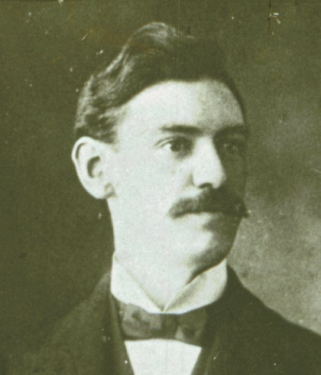
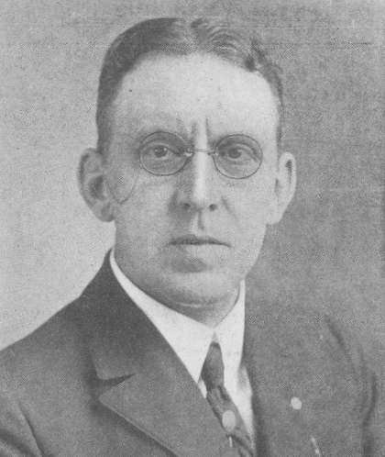
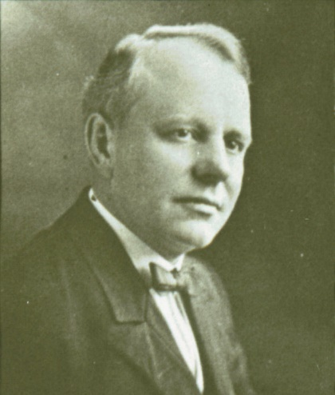
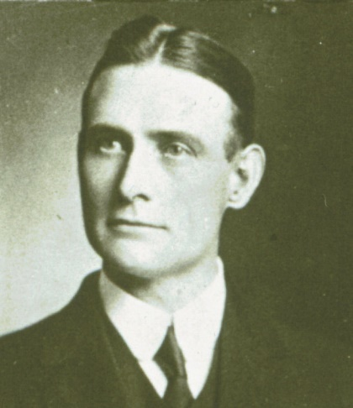
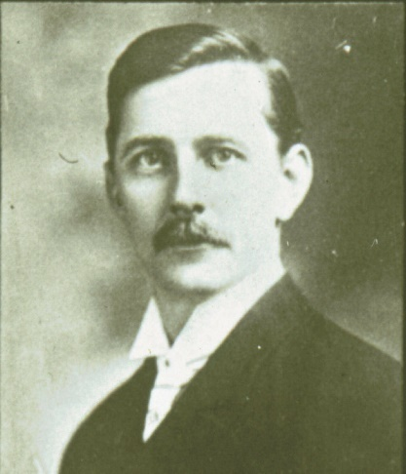
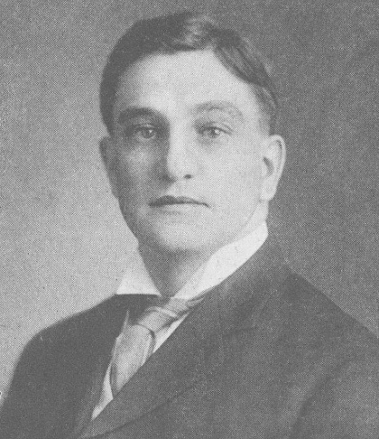
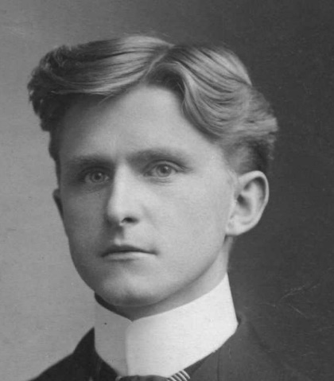
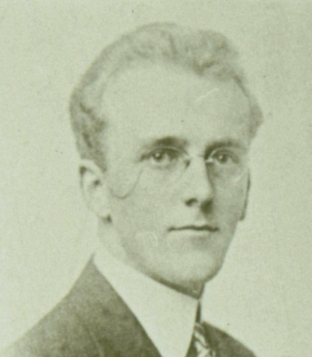
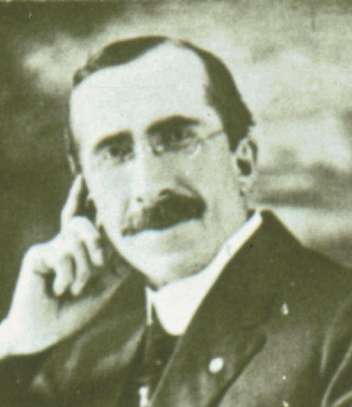
Missouri Synod Deaf Missions Organize
Immediately, after the convention the Board was able to place two missionaries – one at Louisville and the other at Milwaukee.
Over the next few years more men became missionaries, some left, and a few reentered.
Notes:
Missouri Synod Deaf Missions Organize
Immediately, after the convention the Board placed two missionaries – Rev. Herman Bentrup at Louisville and Rev. Traugott Wangerin at Milwaukee.
Over the next few years more men became missionaries, some left, and a few reentered. The earliest missionaries included those pictured.

Slide 14
Missouri Synod Deaf Missions Organize
Herman Bentrup – Louisville
Traugott Wangerin – Milwaukee
Arthur Reinke – Chicago
Enno Duemling – Detroit
Hermann Hallerberg – St. Louis
Arthur Boll – Louisville / New York City
John Salvner -- Minneapolis
Nathaniel Jensen – Kansas City / California
Th. Ernst Claus – South Bend, IN
1.
2.
3.
4.
5.
6.
7.
8.
9.

Slide 15
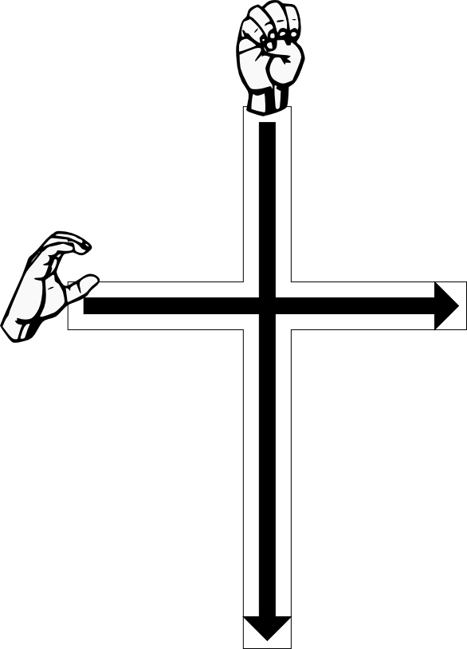
Missouri Synod Deaf Missions Organize
On May 13, 1903, eight missionaries meet in Chicago and form Ephphatha Conference.
EC functions like a regular pastoral conference, but the topics focus on Deaf work.
Notes:
On May 13, 1903, eight missionaries met in Chicago and organized Ephphatha Conference. (The graphic on this screen shows how we sign it – E C.) EC functions like a regular pastoral conference, but the topics focus on Deaf work.

Slide 16
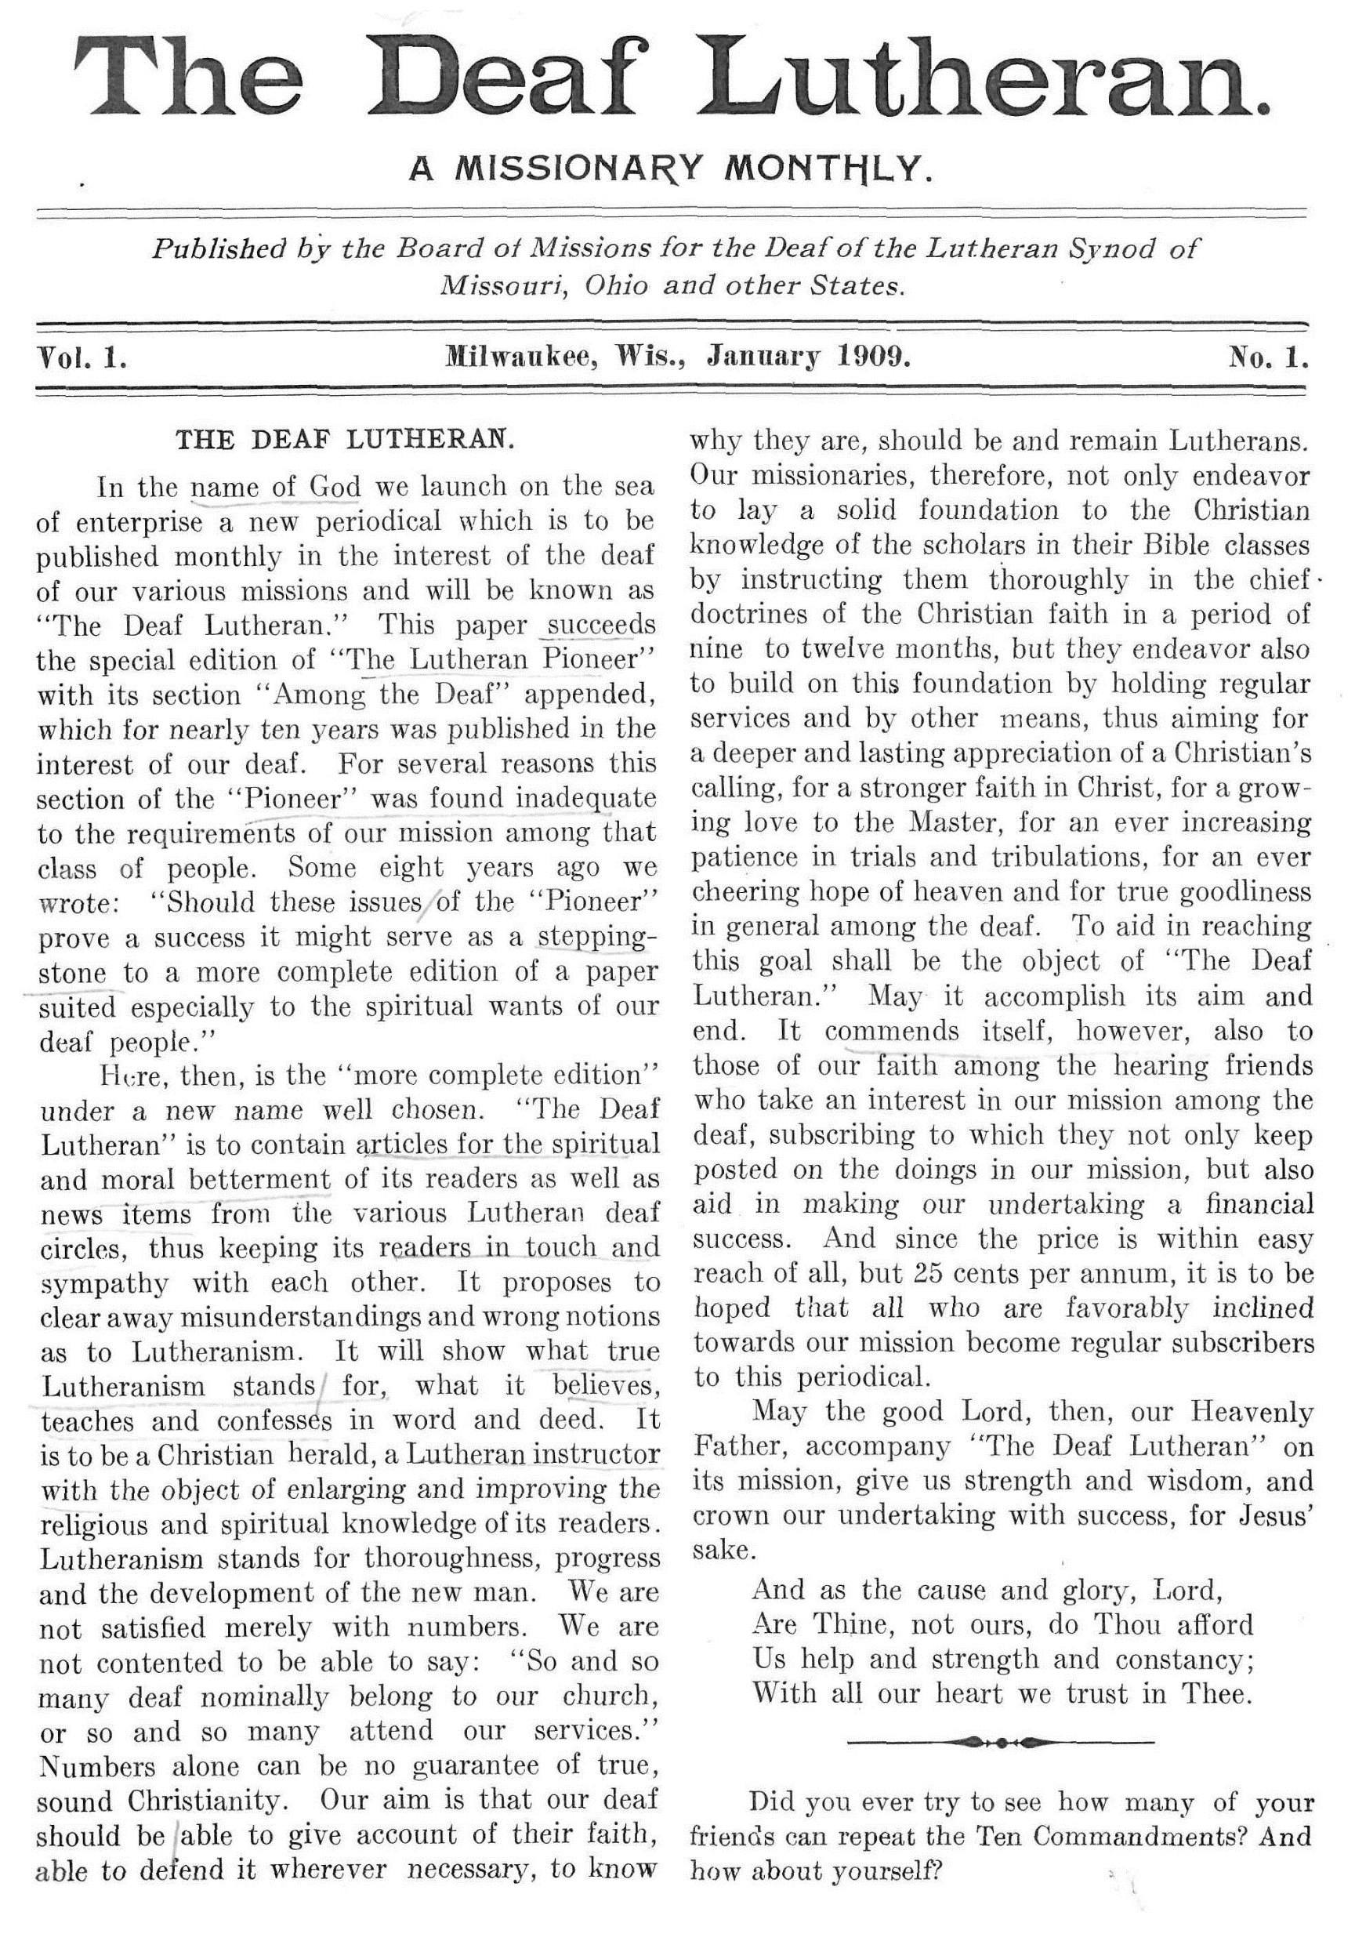
Missouri Synod Deaf Missions Organize
Occasionally, articles about Deaf missions appeared in various Synod publications, but it wasn’t enough.
In January 1909 the Deaf Mission Board launches a new magazine – The Deaf Lutheran: A Missionary Monthly.
The first editor was Rev. Traugott Wangerin of Milwaukee.

Slide 17
Missouri Synod Deaf Missions Organize
Purposes of The Deaf Lutheran:
To provide articles for spiritual and moral improvement of the readers,
To provide news on mission activities and keep readers in touch,
To show what true Lutheranism believes, teaches, and confesses in word and deed,
To recruit financial support for the mission.

Slide 18
1909 1949
Notes:
We now jump to 1949.

Slide 19

Regional Conferences
The suggestion of conferences for Deaf lay people first appeared in the minutes of the 1938 Ephphatha Conference.
The first regional conference (Dixie) was held eleven year later at Shreveport, Louisiana, on January 29-30, 1949.
This Photo by Unknown Author is licensed under CC BY-NC-SA
Notes:
Regional Conferences

Slide 20
Regional Conferences
Objectives of the Dixie conference:
stimulation of deaf interest in our Lutheran mission,
eradication of an inferiority complex of some deaf,
promotion of closer relationship among the deaf and the hearing, and
formation of plans for a permanent organization.
Notes:
As reported in The Deaf Lutheran, the objectives of the Dixie conference were
1. stimulation of deaf interest in our Lutheran mission,
2. eradication of an inferiority complex of some deaf,
3. promotion of closer relationship among the deaf and the hearing, and
4. formation of plans for a permanent organization.
The second objective seems odd, but it was addressing the old attitude “deaf can’t.” These conferences were to be opportunities to promote Deaf peoples’ confidence in becoming leaders.

Slide 21
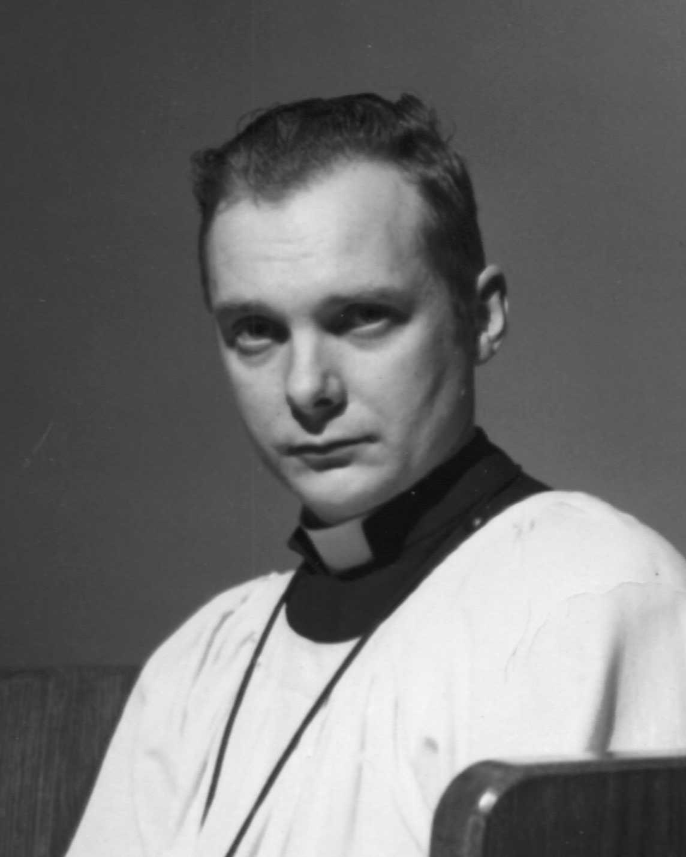
Lutheran Deaf Mission Society (I)
Rev. George Kraus approaches other pastors on the East Coast, and together they form the Lutheran Deaf Mission Society in 1951.
The purpose of the society is to gather funds for doing mission work among the Deaf of foreign lands.
Notes:
Lutheran Deaf Mission Society (I)
Rev. George Kraus approached other pastors on the East Coast, and together they formed the Lutheran Deaf Mission Society in 1951. (This is not the same as the LDMS that was formed in 2009.)
The purpose of the society was to gather funds for doing mission work among the Deaf of foreign lands.

Slide 22
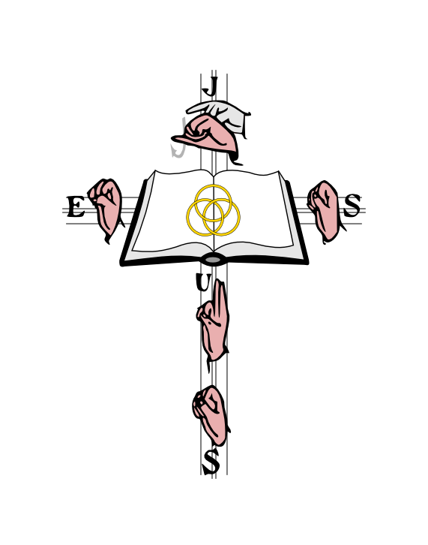
Lutheran Deaf Mission Society (I)
LDMS had a rough beginning with some pastors and Deaf preferring to support national and local missions.
The society funded a trip to the Far-East, which resulted in the opening of the first foreign deaf mission work.
LDMS also funded and sent Rev. Gerhold on an exploratory mission trip to Ghana and Nigeria.
Notes:
A Push for a National Conference – 1st Try

Slide 23
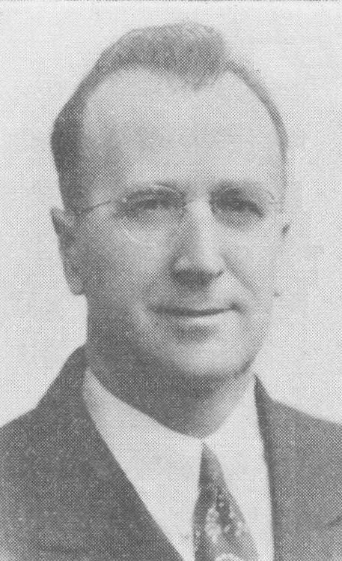
A Push for a National Conference – 1st Try
In 1959 the Midwest Region suggests that a national Deaf Lutheran Conference might be held some day.
The following year (1960) at EC Rev. Theodore Frederking – the Father of ILDA – leads a discussion on “Should We Initiate a National Convention of Lutheran Deaf People?”
The Conference recommends that Frederking discuss this matter with the Board.
Notes:
A Push for a National Conference – 1st Try
.

Slide 24
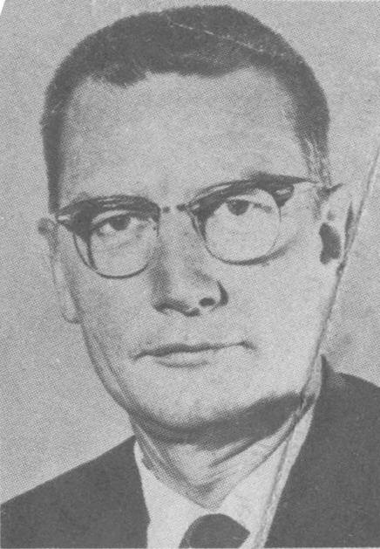
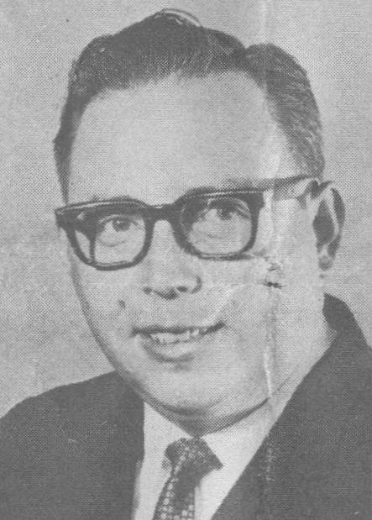
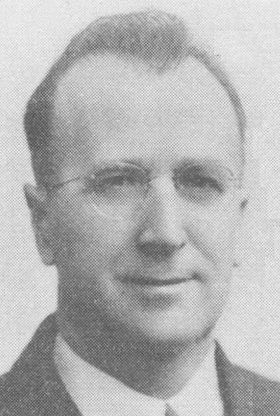
A Push for a National Conference – 1st Try
In 1961 Ephphatha Conference appoints a committee to study the matter and bring recommendations.
The committee includes Frederking and two others: Wayne Bottlinger and August Hauptmann
The committee returns in 1962 with a proposal describing the purposes and structure of a national group.
Hauptmann
Bottlinger
Frederking
Notes:
A Push for a National Conference – 1st Try

Slide 25
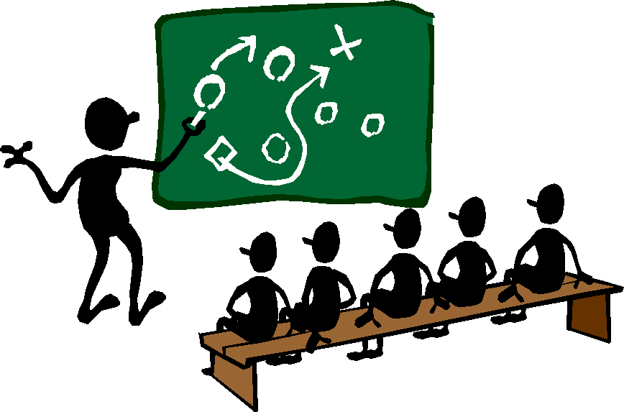
A Push for a National Conference – 1st Try
The committee put forth the aims of a National Lutheran Conference of the Deaf:
  to support the unity of faith;
  to encourage one another in the work of the Kingdom of God among the deaf;
  to support the cause of the Deaf
  Mission Society; and
  to exchange ideas and techniques of
  our church work among the deaf in
  our various areas.
This Photo by Unknown Author is licensed under CC BY-NC-SA
Notes:
A Push for a National Conference – 1st Try

Slide 26

A Push for a National Conference – 1st Try
1962
Ephphatha
Conference turns down proposal.
This Photo by Unknown Author is licensed under CC BY-NC-SA
Notes:
Ephphatha Conference discussed the proposal and defeated it. There were no details of the discussions or reasons given for defeating the proposal.

Slide 27

A Push for a National Conference – 2nd Try
There were changes in the 1960s that forced us to again look at a National Conference of the Deaf.
Synod dissolved all mission boards and
created one general mission board, which
began its work January 1966
Synod decided to transfer supervision
and support of Deaf Missions to the
Districts.
This Photo by Unknown Author is licensed under CC BY
Notes:
A Push for a National Conference – 2nd Try

Slide 28

A Push for a National Conference – 2nd Try
In 1967, the Synod names the regional counselors as an ad hoc committee to study Deaf Mission administration.
The committee determines that it is important to maintain and nurture the unity among the Lutheran Deaf
and to provide opportunities for leadership
and training.
One recommendation us the creation of
an International Lutheran Deaf Association.
This Photo by Unknown Author is licensed under CC BY-SA
Notes:
.
A Push for a National Conference – 2nd Try

Slide 29
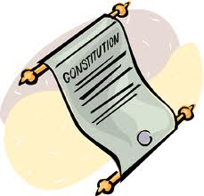
A Push for a National Conference – 2nd Try
The 1969 Synod convention finalizes the decision to give Districts oversight of Deaf Missions.
The Mission Board proceeds with the plan for
an ILDA.
In April 1970 the proposed Constitution is
completed and sent to all congregations.
This Photo by Unknown Author is licensed under CC BY-SA
Notes:
A Push for a National Conference – 2nd Try
The 1969 Synod convention finalized the decision to give Districts oversight of Deaf Missions. A resolution that would give convention blessing on the ILDA never made it to the floor for debate, because other concerns took precedence.
The Mission Board itself decided to proceed with plans for organizing the ILDA.
In April 1970, the proposed Constitution was completed and sent to all deaf congregations.

Slide 30

A Push for a National Conference – 2nd Try
A committee is formed to plan the constituting (first) convention of ILDA to be held at Chicago, July 16-18, 1971.
It includes the regional advisors and one lay representative from each region.
It chooses temporary officers and
divides the preparation work among
the regions.
This Photo by Unknown Author is licensed under CC BY-SA
Notes:
A Push for a National Conference – 2nd Try

Slide 31
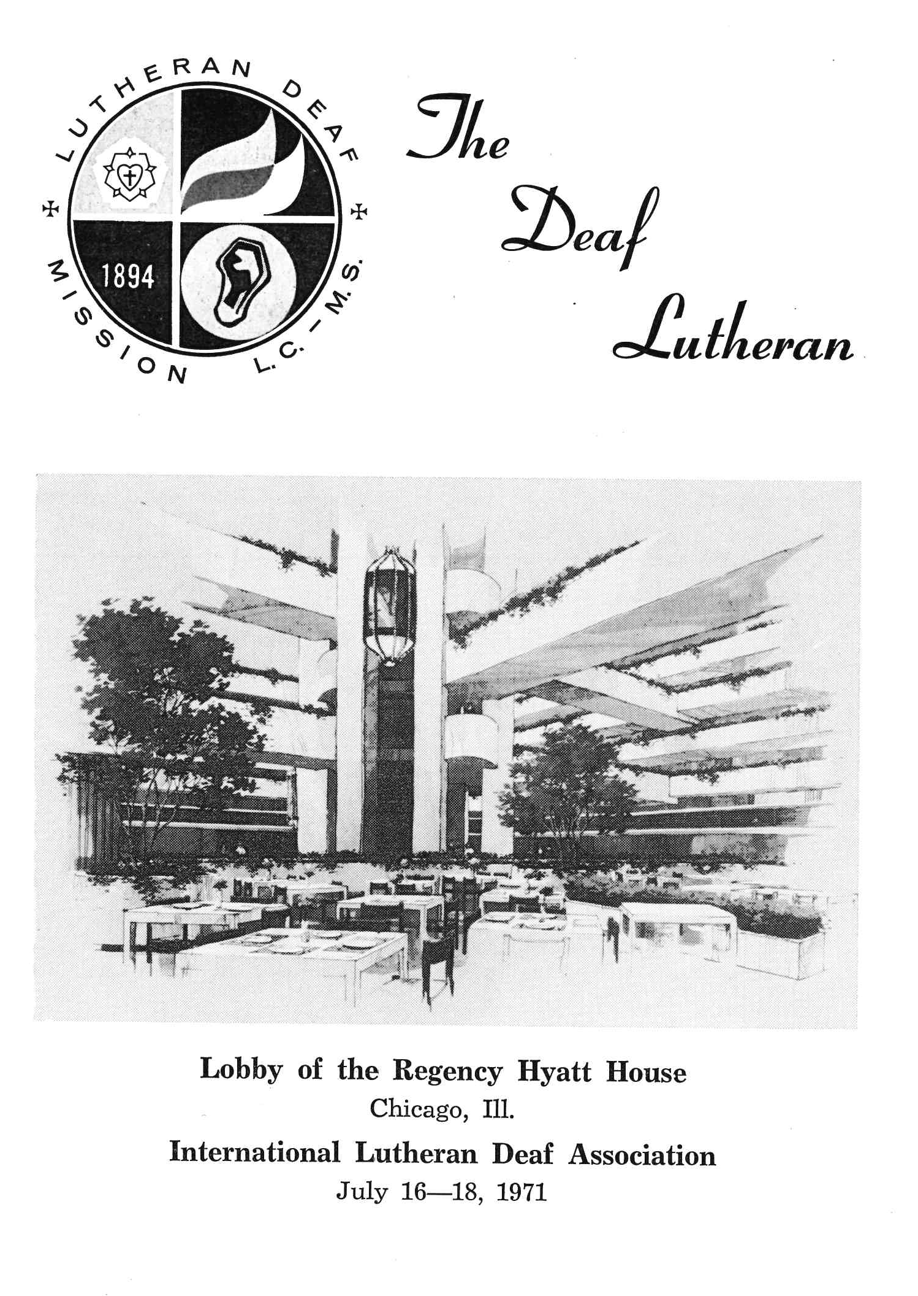
Publicity & Promotion
The committee and Synod begins the work of promoting ILDA.
Articles, pictures and registration appear in The Deaf Lutheran.
A banner contest is planned.
There is even a contest to create an emblem for ILDA.
Notes:
Publicity & Promotion
The committee and Synod began in earnest the work of promoting ILDA. Articles, pictures and registration appear in The Deaf Lutheran. A banner contest is planned. There is even a contest to create an emblem for ILDA.

Slide 32
What is the purpose of ILDA?
The general purpose of the International Lutheran Deaf Association (ILDA) is to promote the Christian faith and life of Lutheran deaf persons and all the deaf throughout the world.
A specific goal is to build and support lay leadership among deaf Lutherans in all areas of religious life, faith, activity, and service.
ILDA shall also develop programs to be used in the church for the spiritual strength and growth of deaf members of all ages.
TDL, Feb 1971, 22
Notes:
What is the purpose of ILDA?
The Deaf Lutheran (Feb 1971, 22) explained:
The general purpose of the International Lutheran Deaf Association (ILDA) is to promote the Christian faith and life of Lutheran deaf persons and all the deaf throughout the world.
A specific goal is to build and support lay leadership among deaf Lutherans in all areas of religious life, faith, activity, and service.
ILDA shall also develop programs to be used in the church for the spiritual strength and growth of deaf members of all ages.

Slide 33
ILDA – Why?
Unity – to strengthen the church in its mission
Identity – to be seen and known in mission
Self-determination – to have a voice in the goals and plans for the future of our mission.
Rev. Herbert Rohe,
Secretary for Deaf Missions
TDL, Feb 1971, 24
Notes:
Rev. Herbert Rohe, Secretary for Deaf Missions, also wrote in The Deaf Lutheran (Feb 1971, 24) about why there should be an ILDA.
Unity – to strengthen the church in its mission
Identity – to be seen and known in mission
Self-determination – to have a voice in the goals and plans for the future of our mission.

Slide 34

July 16 – 18, 1971
Chicago, Illinois
This Photo by Unknown Author is licensed under CC BY-SA
Notes:
ILDA – A Reality
July 16 – 18, 1971
Chicago, Illinois

Slide 35
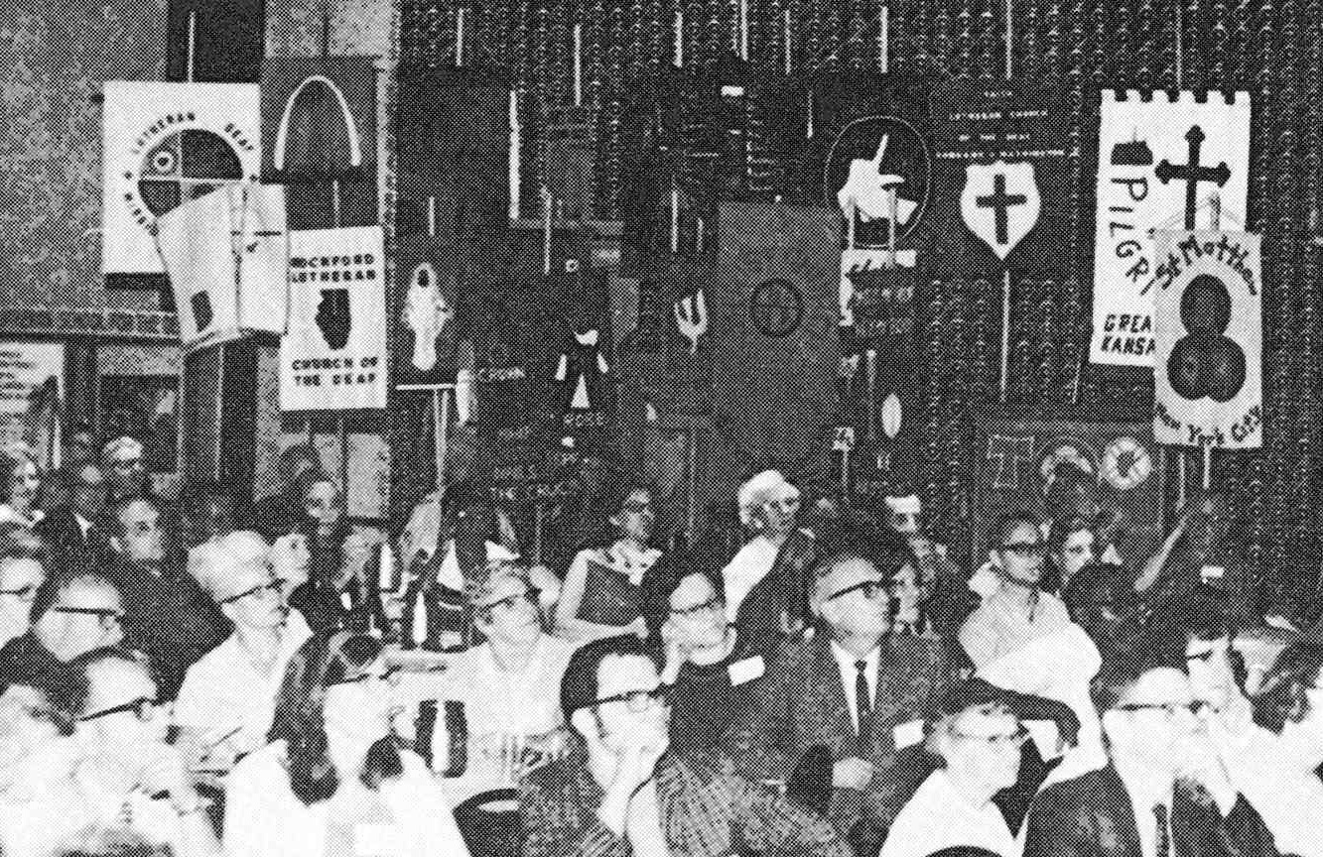
About 350 people registered for ILDA
Notes:
ILDA – A Reality
July 16 – 18, 1971
Chicago, Illinois

Slide 36
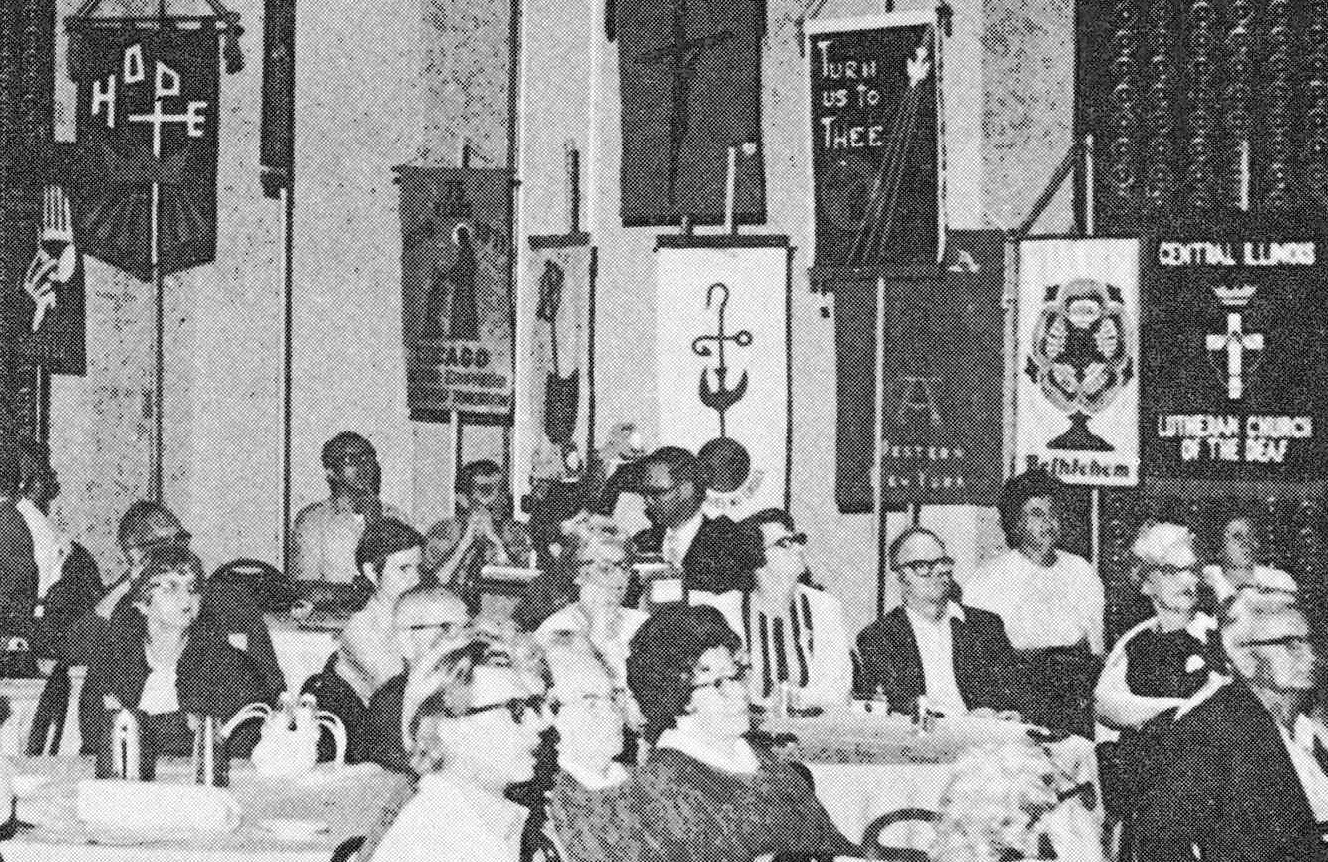
About 350 people registered for ILDA
Notes:
ILDA – A Reality
July 16 – 18, 1971
Chicago, Illinois

Slide 37
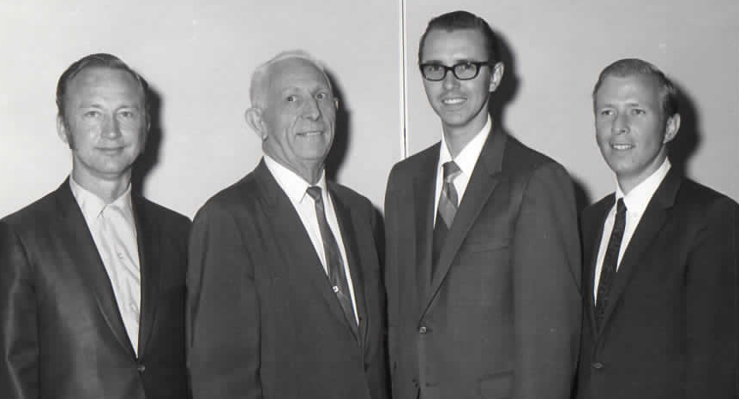
Officers are Elected
Robert Baker
Secretary
Uriel Jones
President-Elect
Marion Van Manen
President
Gary Schlub
Treasurer
Notes:
ILDA – A Reality
July 16 – 18, 1971
Chicago, Illinois

Slide 38
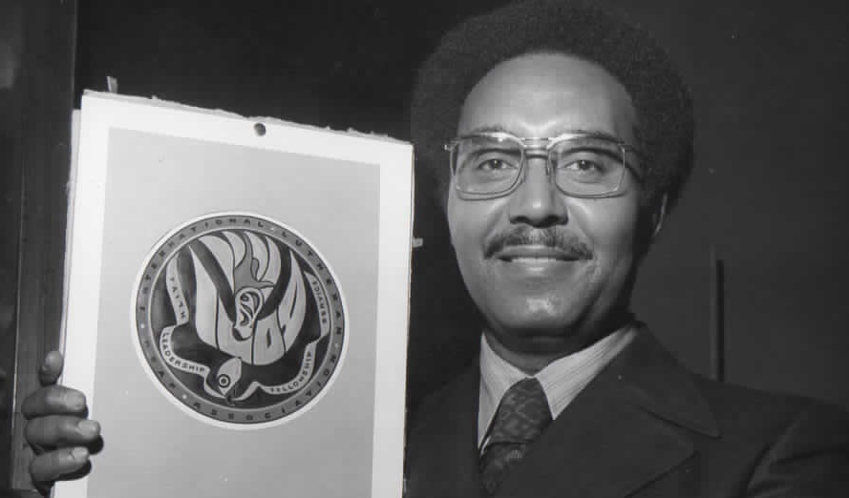
An Emblem is Chosen
Archie Marshall
Notes:
ILDA – A Reality
July 16 – 18, 1971
Chicago, Illinois

Slide 39
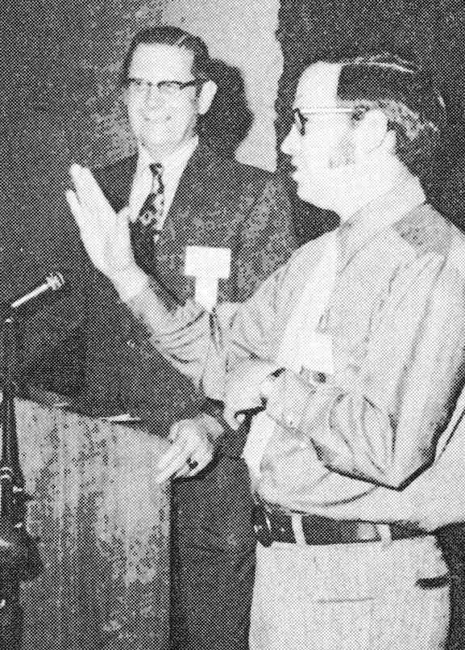
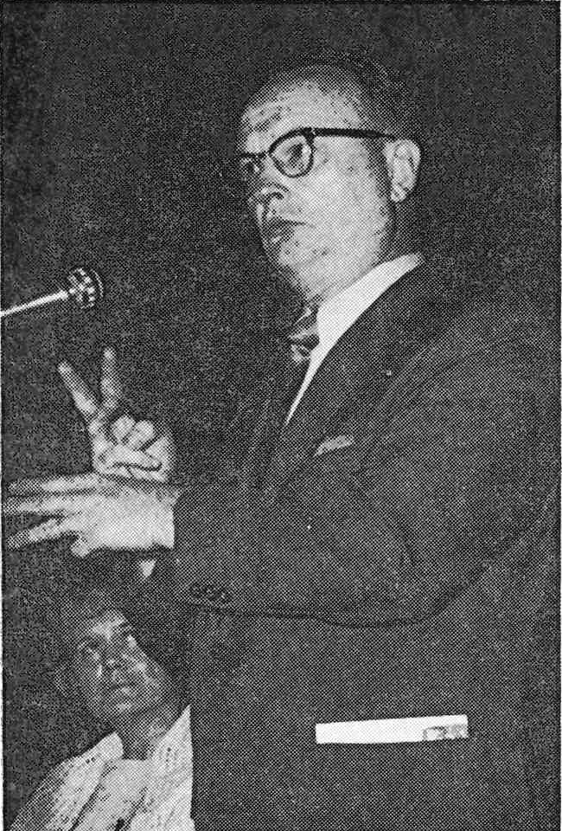
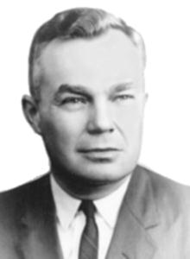
A Host of Speakers
Dr. William Kohn
LCMS Missions
Pastor Charles
Jones
Robert Lankenau
NAD President
Dr. J. A. O. Preus
LCMS President
Notes:
ILDA – A Reality
July 16 – 18, 1971
Chicago, Illinois

Slide 40
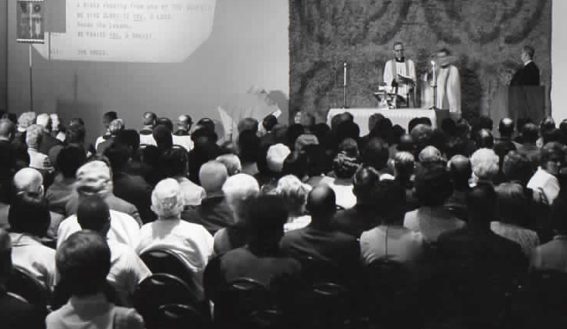
A Time for Worship
Notes:
ILDA – A Reality
July 16 – 18, 1971
Chicago, Illinois

Slide 41
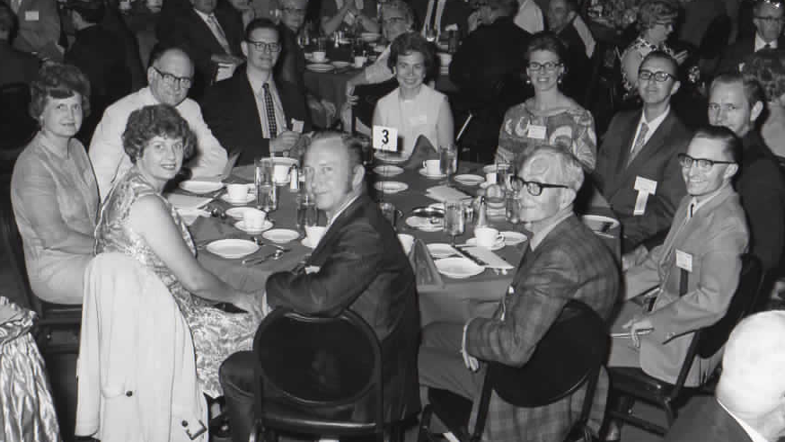
The Schultzs
The Ludwigs
The Van Manens
Rev. George Winkler
A Time for Fellowship and a Banquet
Rev. Quinton Quade
The Bakers
Warren Riege
Notes:
ILDA – A Reality
July 16 – 18, 1971
Chicago, Illinois

Slide 42
The Work of ILDA
In addition to its stated purposes, ILDA also became responsible for several other items.
Adminstering the Lutheran Deaf Mission Society (I)
Editing and publishing The Deaf Lutheran
Electing the regional pastoral advisors/counselors
ILDA became a voice for the Deaf to provide input, guidance and leadership in LCMS mission work – home and abroad.
Notes:
The Work of ILDA

Slide 43
Concluding Thoughts
It was almost a century from the founding of the Deaf School in Detroit (1873) until ILDA began (1971).
We may look back at certain events and decisions with criticism, but at the same time we see the hand of God at work.
ILDA came about at the right time place, in the right time, for the right purpose.
As for the future? … As in the past, the future in God’s hands.

Slide 44
Notes:
ILDA Emblem

